Slide 1
Memory Management and Virtual Memory

Slide 2
Memory
The memory is that part of the computer where programs and data are stored.
Memories consist of a number of cells (or locations), each of which can store a piece of information.
Each cell has a number, called its address, by which programs can refer to it.
If a memory has n cells, they will have addresses 0 to n − 1.
All cells in a memory contain the same number of bits.

Slide 3
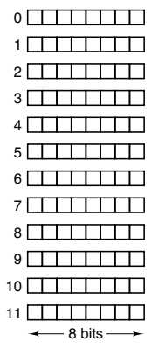
Memory Example

Slide 4
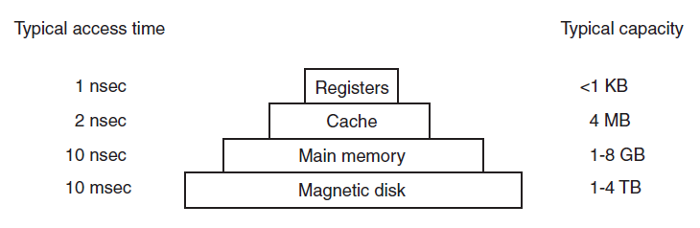
Memory Hierarchy
Fastest access
Slowest access

Slide 5
Technologies used in Memory Design
Two types of memories
Random Access Memory (RAM): Memory from where data can be read and where data can be written at any random location
Static RAM (SRAM)
Dynamic RAM (DRAM)
Read Only Memory (ROM): Memory from where data can be read, but not where data can be written
Useful for booting up, fixed data

Slide 6
Static RAM (SRAM)
Static RAMs (SRAMs) are constructed internally using circuits similar to a D flip-flop
These memories retain their contents as long as the power is kept on: seconds, minutes, hours, even days
They are very fast
A typical access time is a nanosecond or less
For this reason, static RAMS are popular as cache memory

Slide 7
Dynamic RAM (DRAM)
Dynamic RAMs (DRAMs) do not use flip-flops
Instead, a dynamic RAM is an array of cells, each cell containing one transistor and a tiny capacitor
The capacitors can be charged or discharged, allowing 0s and 1s to be stored
Because the electric charge tends to leak out, each bit in a dynamic RAM must be refreshed (reloaded) every few milliseconds to prevent the data from leaking away
Since dynamic RAMs need only one transistor and one capacitor per bit (vs six transistors per bit for the best static RAM), dynamic RAMs have a very high density (many bits per chip)
For this reason, main memories are nearly always built out of dynamic RAMs
However, this large capacity has a price: dynamic RAMs are slow (tens of nanoseconds)

Slide 8
Read Only Memory (ROM)
The data in a ROM are inserted during its manufacture, essentially by exposing a photosensitive material through a mask containing the desired bit pattern and then etching away the exposed (or unexposed) surface
The only way to change the program in a ROM is to replace the entire chip
ROMs are much cheaper than RAMs when ordered in large enough volumes to defray the cost of making the mask
However, they are inflexible, because they cannot be changed after manufacture

Slide 9
Basic Concepts
Note that both processes have their own address space starting from 0 to some number
Physical memory (RAM)
Address space: Set of addresses that a process can use to address memory
Each process has its own address space
Dynamic relocation maps the address space of each process onto a different part of physical memory (i.e. RAM)
Process P2
Address space: 0 to 1000
Address 6000
Address 5000
Process P1
Address space: 0 to 3500
Address 4000
Address 3000
Address 2000
Address 1000
But the real physical addresses are different
Address 0

Slide 10
Base and Limit Register
Two CPU registers are used to track this
When a process is run:
The base register is loaded with the physical address where its program begins in memory
The limit register is loaded with the length of the program
Every time a process references memory, the CPU hardware automatically adds the base value to the address generated by the process
It also ensures that this value is less than that in the limit register
For our previous diagram:
When process P1 is run:
Base register = 0
Limit register = 3500
When process P2 is run:
Base register = 4000
Limit register = 5000
Now consider that process P2 has referenced memory location 300
The CPU hardware will add the base register value to it, making the address 4300
But before accessing physical memory location 4300, it will also verify that this is less than the limit register value of 5000

Slide 11
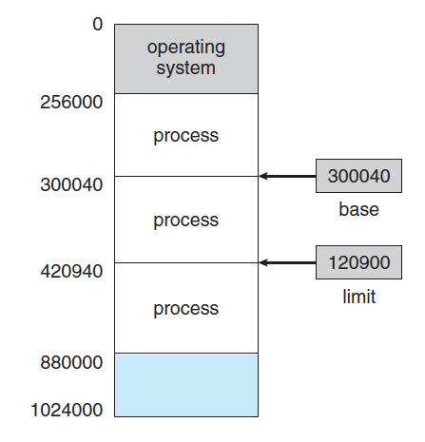
Memory and Protection: Example
If the base register contains 300040 and limit register contains 120900, then the program can legally access all addresses from 300040 to 420939.

Slide 12
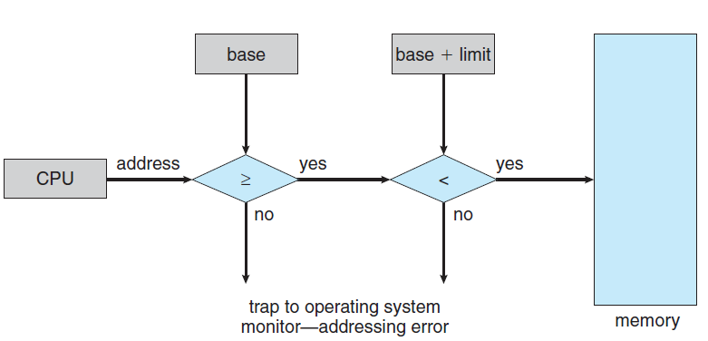
Trap Concept
Any attempt by a program executing in user mode to access operating-system memory or other users’ memory results in a trap to the operating system, which treats the attempt as a fatal error.
This scheme prevents a user program from (accidentally or deliberately) modifying the code or data structures of either the operating system or other users.

Slide 13
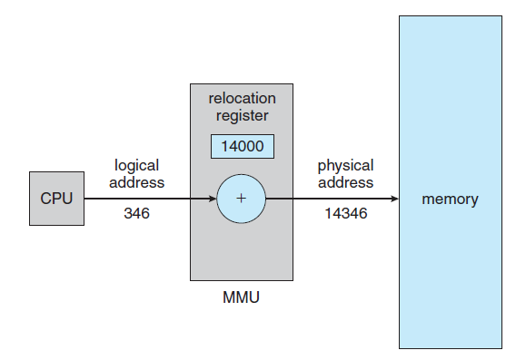
Logical and Physical Address Space
Base register is now called relocation register
An address generated by the CPU is commonly referred to as a logical address (or virtual address), whereas an address seen by the memory unit is the physical address.
Virtual-to-Physical address mapping is done.
Actual Physical memory address = Relocation register value + Logical address generated by the user process

Slide 14
Contiguous and Dynamic Memory Allocation

Slide 15
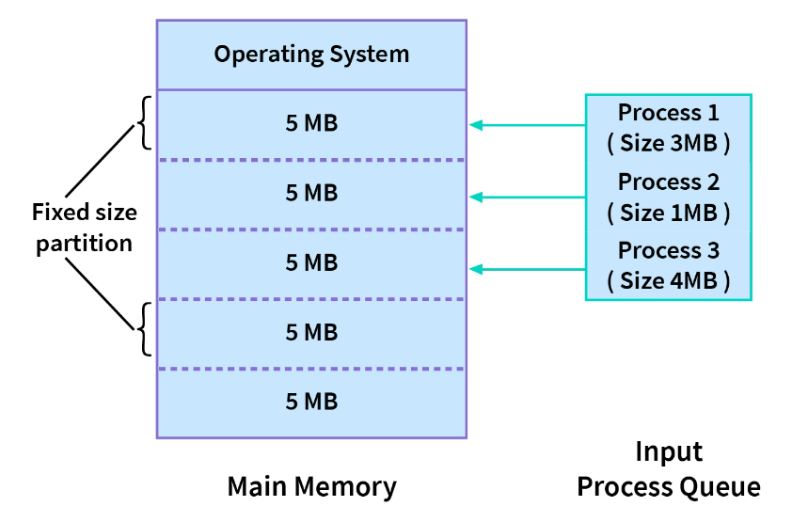
Contiguous Memory Allocation
The memory is usually divided into two partitions: one for the operating system and one for the user processes.
In contiguous memory allocation, each process is allocated a single section of memory that is contiguous to the section containing the next process.
Contiguous memory allocation can be of fixed-size partitions (as shown here) or variable-size partitions (different sized partitions)

Slide 16
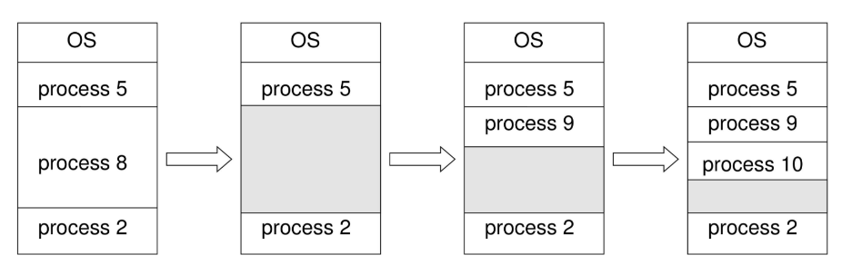
Dynamic Memory Allocation
In dynamic memory allocation, memory is not allocated contiguously to the incoming processes.
Here, one of the three strategies is used:
First fit. Allocate the first free block that is big enough.
Best fit. Allocate the smallest free block that is large enough.
Worst fit. Allocate the largest free block.
Process 8 goes out, 9 and 10 come in

Slide 17
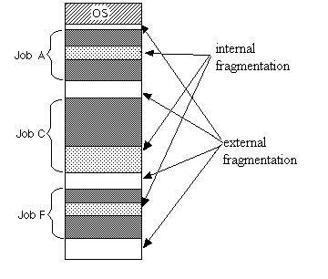
Fragmentation
Both the first-fit and best-fit strategies for memory allocation suffer from external fragmentation – memory blocks available in the memory are not too small and non-contiguous
Internal fragmentation—Unused memory that is internal to a partition, because a process does not fully utilize the allocated memory.

Slide 18
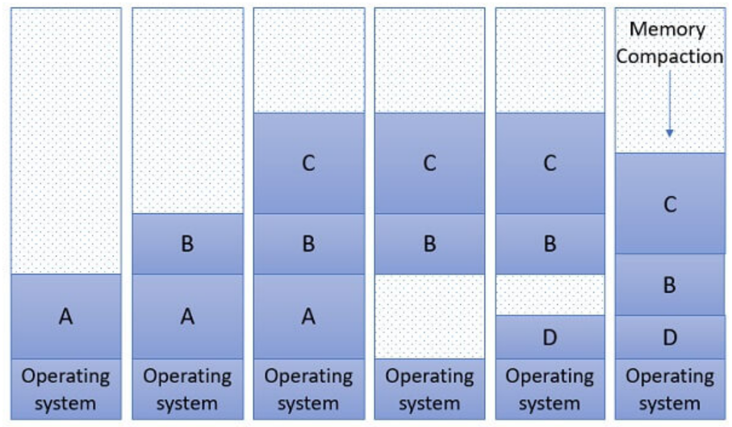
Compaction
One solution to the problem of external fragmentation is compaction.
The goal is to shuffle the memory contents so as to place all free memory together in one large block.
Compaction is not always possible, however. If relocation is static and is done at assembly or load time.

Slide 19
Segmentation

Slide 20
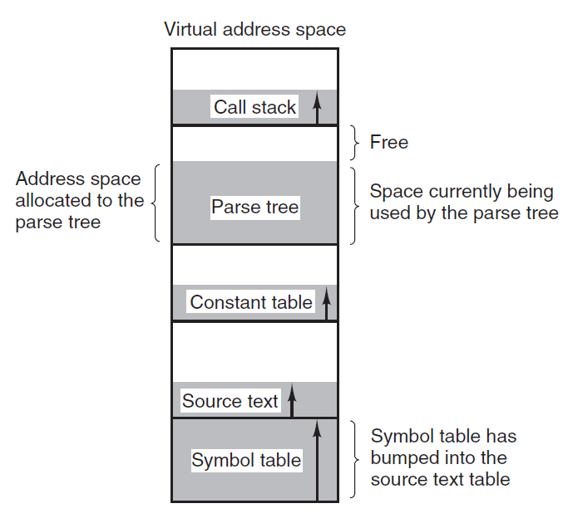
Segmentation
When a compiler compiles a program, it uses many tables: symbol table, source text, constants, parse tree, call stack, …
Memory needs of these tables are different (not of the same size)
Here, it is better to provide the computer with many completely independent address spaces, called as segments

Slide 21
Segmentation
In segmentation, we consider the main memory to be made up of a collection of segments
Logical address of a segment has two parts: segment number and offset
Each segment is a linear sequence of addresses from 0 to some maximum value
A segment is a logical entity
Different segments can have different lengths, capped by the maximum value mentioned above
Segment lengths can change during program execution, if necessary
So, different segments can grow or shrink without affecting other segments

Slide 22
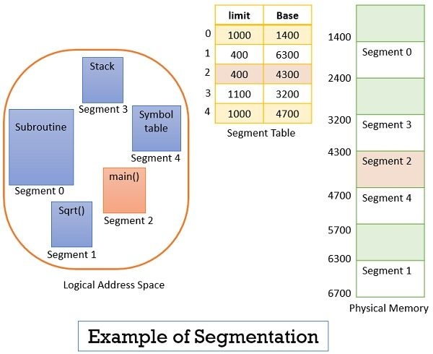
Segmentation Example
Consider a user program divided into five segments, numbered 0 to 4

Slide 23
Segmentation Example
Suppose the CPU calls for segment number 2, whose length is 400 bytes, starting at physical memory address 4300
The CPU wants to read the 53rd byte in this segment
So, the CPU informs the operating system that I want data at segment number 2, offset 53
As we can see, the offset 53 is between 0 and the limit of the segment, which is 400
So, the operating system will read this byte as: Base register + Offset for the given segment, which is: 4300 + 53 = Byte at physical memory location 4353

Slide 24
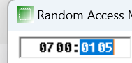
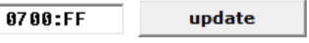
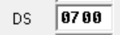
Segmentation: Demo
In the emu8086 program, start a new program then click on Emulate, Single step:
org 100h
mov [0xff], 0x30
ret
After executing the mov statement, click on View-Memory
Change this address to FF and click Update
We will see hex 30 at this memory location
Note that the Data Segment register (DS) has 0700

Slide 25
Segmentation Demo: Conclusion
Our statement: mov [0xff], 0x30
Actual working: Because the data segment begins at segment address 0700, the actual address is not 0x30, but it is 0700:FF
In the address 0700:FF, 0700 is the segment address and FF is the offset address
To convert it to decimal, formula is: (Segment address x 16) + Offset address = (1792 x 16) + 255 = 28927 … Another way to calculate is in the calculator program, select Hex and type 07000 + FF. Result will be the same.

Slide 26
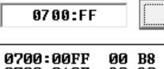
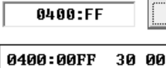
Segmentation: Changing the Data Segment Address
org 100h
mov ax, 0x400
mov ds, ax
mov [0xff], 0x30
ret
Now if we step through, we will see that the DS gets a value of 0400
Let us look at what is stored at memory address 0700:FF, as before Here, we do not have 30
What about 0400:FF? Now we do see the value 30

Slide 27
Virtual Memory and Paging

Slide 28
Virtual memory – The need
Consider a computer that has 16-bit memory addresses, but actual physical memory of 4096 words
Real-life example: Suppose we have kept a capacity of 20 digits in the phone number, but actually phone numbers are only of 10 digits
Let us take a similar example for computer memory

Slide 29
Virtual memory – The need
Suppose we have a 16-bit computer
This means that the computer has 16 wires between the CPU and the main memory of the computer
So, the actual addressable addresses (2¹⁶) are 65,536
But suppose the main memory only has 4096 memory locations
Result: Memory addresses from 4096 to 65,535 are useless for us
See next slide

Slide 30
Main Memory and Addressable Memory
Memory address 65535
Memory address 65534
…
…
Memory address 4095
Memory address 0
Unusable addresses
Memory address 4095
Memory address 4094
…
…
…
Memory address 0
Physical memory
Addressable memory

Slide 31
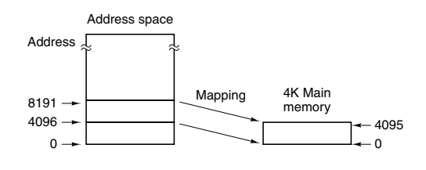
Separating address space and memory locations – Virtual Memory!
At any time, 4096 memory addresses can be directly accessed, but they need not correspond to physical memory locations 0 to 4095
We could, tell the computer that
Henceforth whenever logical address 4096 is referenced, the physical address 0 is to be used
Whenever logical address 4097 is referenced, the physical memory address 1 is to be used
Whenever logical address 8191 is referenced, the physical memory at address 4095 is to be used, etc
Addressable memory
Real/physical memory (RAM)

Slide 32
Virtual Memory – Benefits
Now a programmer can write a program, which assumes that there are 65,536 locations in the main memory, and not just 4096
In other words, the programmer can utilize the full 16-bit address space, when in reality there are only 4096 real memory locations
Obvious question
What happens if a program branches to an address between 8192 and 12287?

Slide 33
Understanding virtual memory
The contents of main physical memory would be saved on disk
Addresses 8192 to 12287 of the program would be read from the disk
The contents of these addresses, i.e. 8192 to 12287 would be loaded into main physical memory
The address map would be changed to map addresses 8192 to 12287 onto memory locations 0 to 4095
Execution would continue as though nothing unusual had happened
This technique is called paging and the chunks of program read in from disk are called pages

Slide 34
More terminology
The addresses that the program can refer to are in the virtual address space, and the actual, hardwired (physical) memory locations are in the physical address space
A page table or page map table specifies for each virtual address what the corresponding physical address is
For this, both the virtual memory and physical memory is divided into same-sized pages

Slide 35
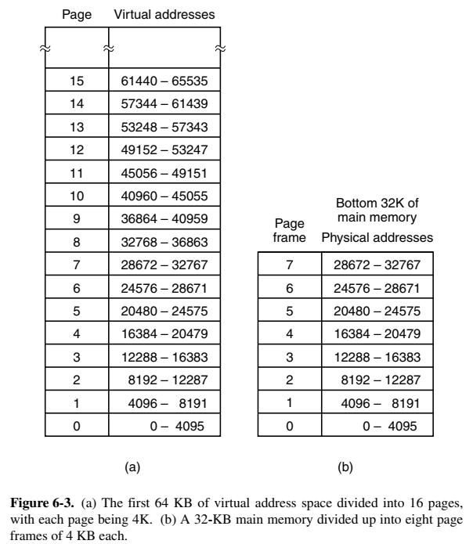
Divide Virtual Memory into Pages and Physical Memory into Page Frames
Physical memory
Virtual memory

Slide 36
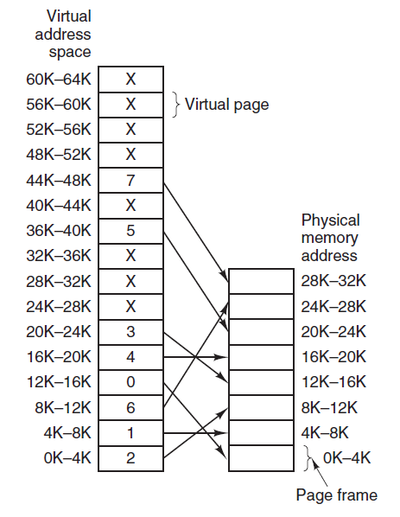
Page Mapping Table or Page Table

Slide 37
Page Replacement – Basic idea
When a program refers to a virtual memory address that is not present in the physical/real main memory, a page fault occurs
Ideally, the set of pages that a program is actively and heavily using, called the working set, can be kept in memory to reduce page faults
When a page fault happens, the operating system must read in the required page from the disk into the main memory
To accommodate it, the operating system must also remove one of the pages from the main memory
Thus an algorithm that decides which page to remove is needed – this is called as page replacement policy

Slide 38
Page Replacement algorithms
Least Recently Used (LRU) algorithm: Evicts the page least recently used because of the probability of its not being in the current working set is high
First In First Out (FIFO): Removes the least recently loaded page, independent of when this page was last referenced. Associated with each page frame is a counter. Initially, all the counters are set to 0. After each page fault has been handled, the counter for each page presently in memory is increased by one, and the counter for the page just brought in is set to 0. When it becomes necessary to choose a page to remove, the page whose counter is highest is chosen.

Slide 39
Thrashing concept
A program that generates page faults frequently and continuously is said to be thrashing
Needless to say, thrashing is an undesirable characteristic to have in your system

Slide 40
Demand Paging
In the purest form of paging, processes are started up with none of their pages in memory
As soon as the CPU tries to fetch the first instruction, it gets a page fault, causing the operating system to bring in the page containing the first instruction
Other page faults for global variables and the stack usually follow quickly
After a while, the process has most of the pages it needs and settles down to run with relatively few page faults
This strategy is called demand paging because pages are loaded only on demand, not in advance

Slide 41
Dirty Bit Concept
Background …
The page table maps virtual addresses to physical addresses
The virtual page number is used as an index in the page table
From this entry, the page frame number (if any) is found, which is the physical memory address reference
Now imagine that a page frame is modified (See next slide)
Virtual page number
Page table
Frame number

Slide 42
Dirty Bit Concept
Let us say that the OS wants to reclaim page frame 7 because of some requirements
However, contents of page frame 7 were modified
The modifications would be lost now
To prevent this, the page table maintains a flag called dirty bit, which is set to 1 whenever a page frame is modified
So now the OS will check the dirty bit flag for page 7
If 0, it will simply reclaim page frame 7
If 1, it will write it back to disk and then reclaim it
Thus, changes made to page frames will not be lost

Slide 43
Shared Pages
In a large multiprogramming environment, several users may run the same program at the same time
Instead of loading different copies of the same program, it is much more efficient to share the same copy with all the users
For this, the page needs to be separated into code and data
Code/instruction pages (I-space) can be shared
Data pages (D-space) cannot be shared (since they may get updated)
Now, two or more processes can share the same page table for their I-space, but different pages tables for their D-space
But, it needs to be done carefully …

Slide 44
Shared Pages
Suppose processes A and B are running an editor and sharing its pages
If the scheduler removes process A, all the pages used by A will also get evicted, filling the empty page frames with some other programs
Process B will need to generate many page faults to bring these back
Reentrant code = Read-only code
Since different processes sharing the same code may modify data but never the code, the code is called reentrant
This means that different processes can execute different parts of the code simultaneously without impacting the code

Slide 45
Throttling
Throttling refers to a mechanism where the operating system intentionally limits or controls certain resources or processes to prevent excessive consumption of resources, maintain system stability, and ensure fairness among different tasks or users
Throttling is commonly used to manage CPU usage, memory usage, network bandwidth, and other system resources
Memory throttling: In systems with limited memory, processes may be limited in the amount of memory they can use. If a process tries to use more memory than allocated, the system may slow down the process or terminate it to prevent a system-wide crash due to excessive memory consumption.

Slide 46
Deadlocks

Slide 47
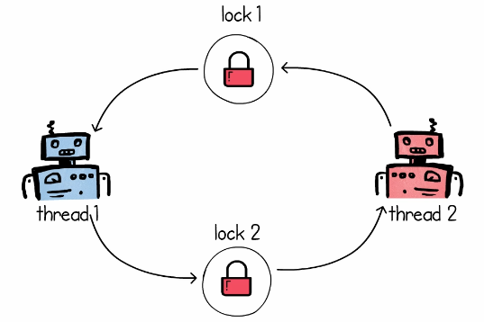
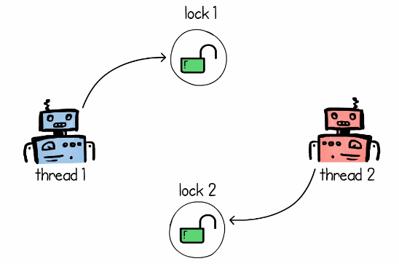
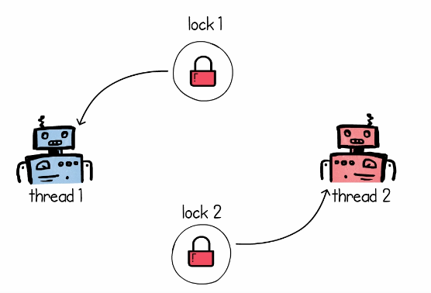
Deadlock
Step 1: Thread 1 asks for Lock 1 on resource R1, Thread 2 asks for Lock 2 on resource R2 – both are successful
Step 2: Soon after, they want a lock on the resource that the other thread has locked
Result: Deadlock

Slide 48
Deadlock Example: C:\lectures\CDAC\DAC\deadlock.py
from threading import Thread, Lock
import time
def red_robot(lock1, lock2):
while True:
print("Red: Acquiring lock 1...")
lock1.acquire()
print("Red: Acquiring lock 2...")
lock2.acquire()
print("Red: Locks acquired...")
lock1.release()
lock2.release()
print("Red: Locks released")
time.sleep(0.5)
def blue_robot(lock1, lock2):
while True:
print("Blue: Acquiring lock 2...")
lock2.acquire()
print("Blue: Acquiring lock 1...")
lock1.acquire()
print("Blue: Locks acquired...")
lock1.release()
lock2.release()
print("Blue: Locks released")
time.sleep(0.5)
mutex1 = Lock()
mutex2 = Lock()
red = Thread(target=red_robot, args=(mutex1, mutex2))
blue = Thread(target=blue_robot, args=(mutex1, mutex2))
red.start()
blue.start()

Slide 49
Necessary Conditions for a Deadlock
The following four conditions must be true at the same time:
Mutual exclusion. Only one process can use a resource.
Hold and wait. A process must be holding at least one resource and waiting to acquire additional resources that are currently being held by other processes.
No preemption. Resources cannot be preempted; that is, a resource can be released only voluntarily by the process holding it.
Circular wait. A set {P0, P1, ..., Pn} of waiting processes must exist such that P0 is waiting for a resource held by P1, P1 is waiting for a resource held by P2, ..., Pn−1 is waiting for a resource held by Pn, and Pn is waiting for a resource held by P0.

Slide 50
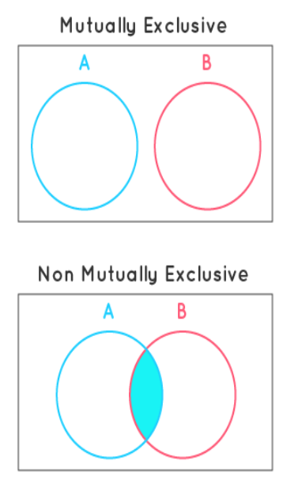
“Mutually Exclusive”

Slide 51
Deadlock Prevention and Avoidance
To ensure that deadlocks never occur, the system can use either a deadlock prevention or a deadlock avoidance scheme.
Deadlock prevention: Never allow all the four deadlock conditions to become true
Deadlock avoidance: Allocate resources to only one process at a time

Slide 52
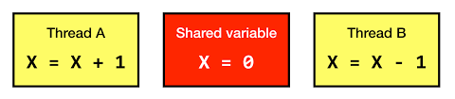
Deadlock Prevention
To prevent a deadlock, we need to examine the four necessary conditions for it and see what can be done
Condition 1: Mutual exclusion
For a deadlock to occur, at least one resource must be non-sharable (i.e. mutual exclusion condition must become true).
Consider a read-only file – it is sharable – processes do not require an exclusive lock on it.
However, how can we practically mandate that all the resources be sharable?
Hence, avoiding mutual exclusion is very difficult.

Slide 53
Deadlock Prevention
Condition 2: Hold and wait
To ensure that the hold-and-wait condition never occurs in the system, we must guarantee that, whenever a process requests a resource, it does not hold any other resources.
Two approaches can be used to handle this:
Each process must request and be allocated all its resources before it begins execution.
Allow a process to request resources only when it has none.
Both these protocols have two main disadvantages.
Resource utilization may be low, since resources may be allocated but unused for a long period.
Starvation is possible. A process that needs several popular resources may have to wait indefinitely, because at least one of the resources that it needs is always allocated to some other process.

Slide 54
Deadlock Prevention
Condition 3: No pre-emption
If a process is holding some resources and requests another resource that cannot be immediately allocated to it (that is, the process must wait), then all resources the process is currently holding are preempted.
In other words, these resources are implicitly released.
The preempted resources are added to the list of resources for which the process is waiting.
The process will be restarted only when it can regain its old resources, as well as the new ones that it is requesting.
This protocol is often applied to resources whose state can be easily saved and restored later, such as CPU registers and memory space.

Slide 55
Deadlock Prevention
Condition 4: Circular wait
Impose a total ordering of all resource types and to require that each process requests resources in an increasing order of enumeration.
Suppose our numbering for resources is Tape drive = 1, Disk drive = 5, Printer = 12.
Now a process that needs the tape drive and the printer at the same time must first request the tape drive and then the printer.

Slide 56
Deadlock Avoidance
Here, we require additional information about how resources are to be requested.
For example, in a system with one tape drive and one printer, the system might need to know that process P will request first the tape drive and then the printer before releasing both resources, whereas process Q will request first the printer and then the tape drive.
With this knowledge of the complete sequence of requests and releases for each process, the system can decide for each request whether or not the process should wait in order to avoid a possible future deadlock.
Each request requires that in making this decision the system consider the resources currently available, the resources currently allocated to each process, and the future requests and releases of each process.

Slide 57
Semaphore
Semaphore is a variable that is used to control access to a common resource
It keeps a count of resource usage and decides if the resource can be made available to a requesting process
Two types
Counting semaphore: Can be any number
Binary semaphore: Semaphore with a value of 0 or 1 only

Slide 58
Semaphore Example
A library has 10 copies of a book
One copy can be used by one student at any given time
A student must request the librarian to issue a book copy
If no copy is available, the student must wait till another student returns her copy
When a student finishes using a copy, the student must return the copy to the librarian
This situation can be modelled by using a semaphore

Slide 59
Semaphore – Key Points
A semaphore only tracks the count of free resources – it does not keep a track of which resources are free
If we use binary semaphore then we only want to know if a resource is free (semaphore = 0) or in use (semaphore = 1)
The Producer-Consumer Problem can be solved using semaphores
It is not a locking mechanism – It is a signalling mechanism
Threads and processes perform wait() and signal() operations to indicate whether they are acquiring or releasing resources

Slide 60
Mutual Exclusion (Mutex)
Mutual Exclusion (Mutex) is an object that allows multiple program threads to share the same resource, such as a file, but not simultaneously
Mutex is different from semaphores
Semaphore is a signaling mechanism, mutex is a locking mechanism
Semaphore may or may not be binary, mutex is always binary
Example follows …

Slide 61
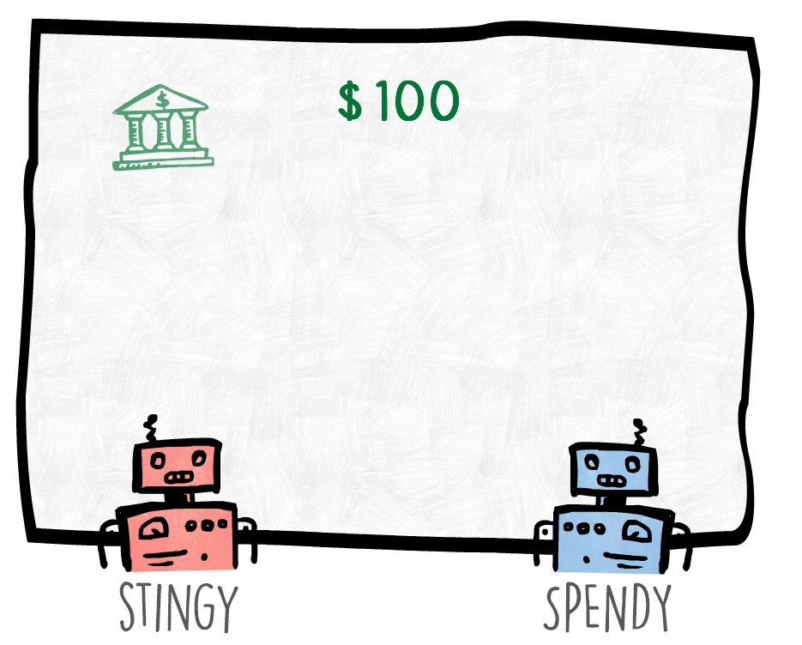
Need for Synchronization
Consider two people, who have access to the same bank account
The first one keeps adding money, the second one keeps spending money
Initial balance is $100

Slide 62
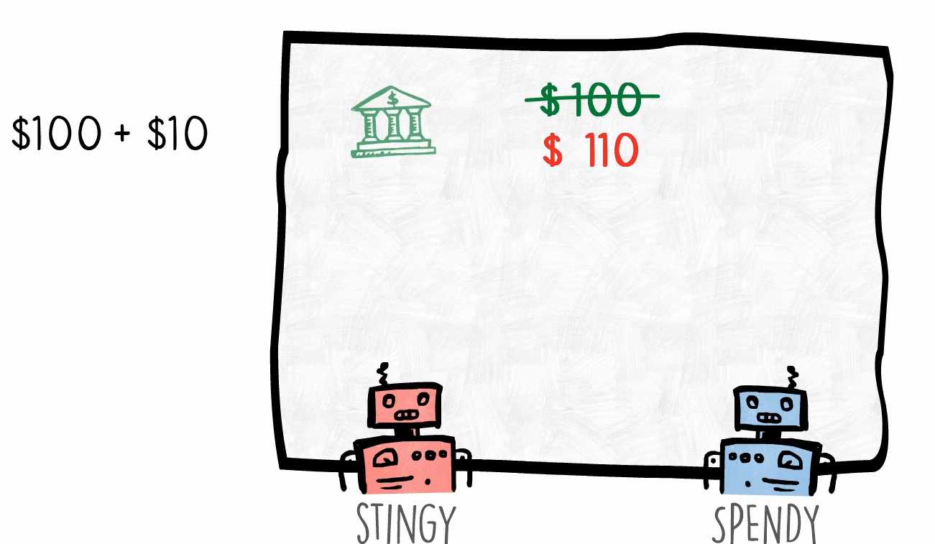
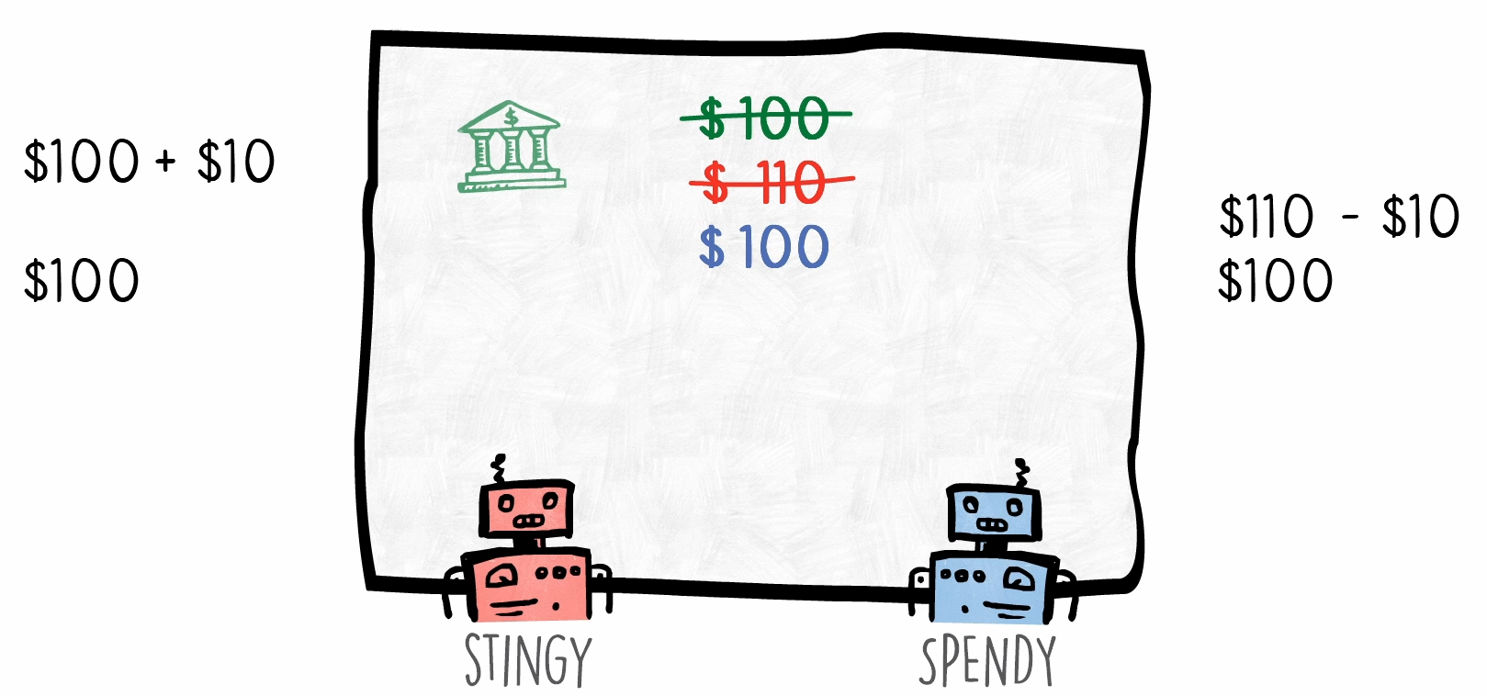
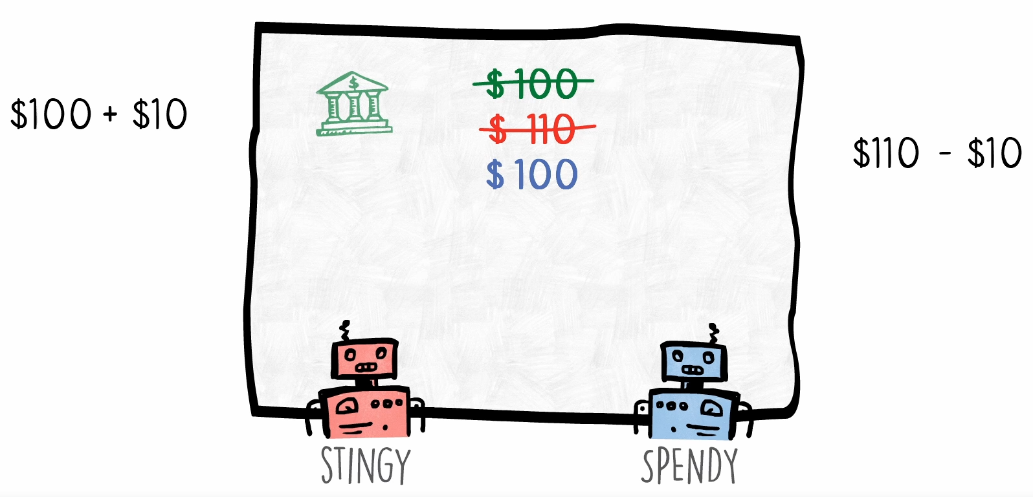
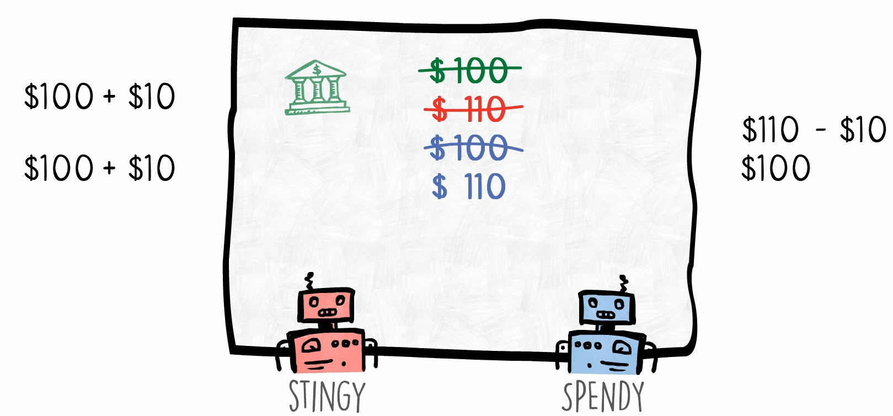
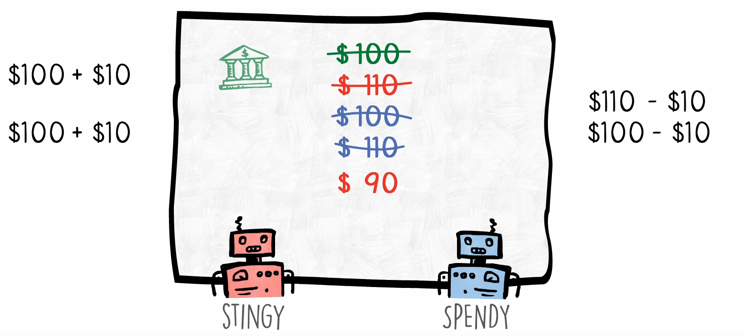
Need for Synchronization
Step 1: Stingy adds $10
Step 2: Spendy immediately spends the $10
Step 3: Both read the balance
Step 4: Both update balance (WRONG! Final balance should be $100)

Slide 63
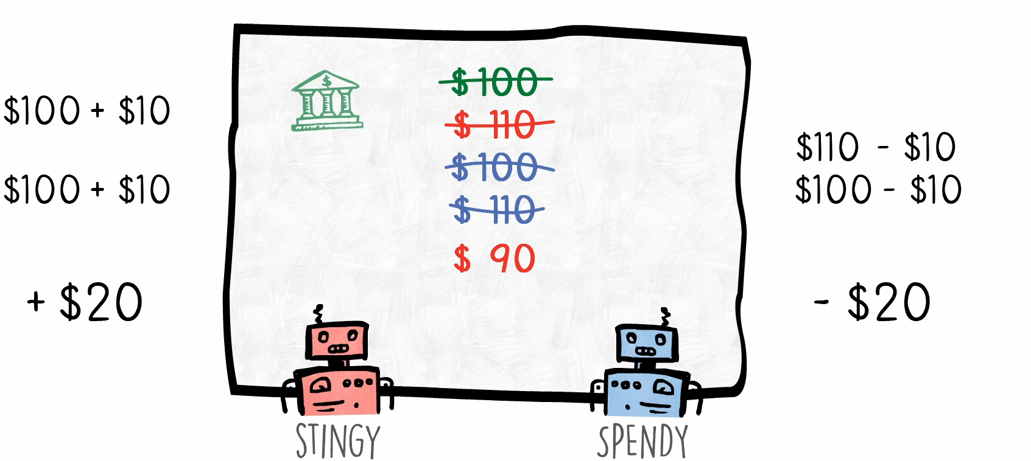
Race Condition
Because $20 were added and spent, the final balance should have been $100
But it is not – this is called as race condition

Slide 64
Race Condition Example: C:\lectures\CDAC\DAC\stingy_spendy.py
import time
from threading import Thread
class StingySpendy:
money = 100
def stingy(self):
for i in range(50000000):
self.money += 10
print("Stingy Done")
def spendy(self):
for i in range(50000000):
self.money -= 10
print("Spendy Done")
ss = StingySpendy()
Thread(target=ss.stingy, args=()).start()
Thread(target=ss.spendy, args=()).start()
time.sleep(5)
print("Money in the end", ss.money)

Slide 65
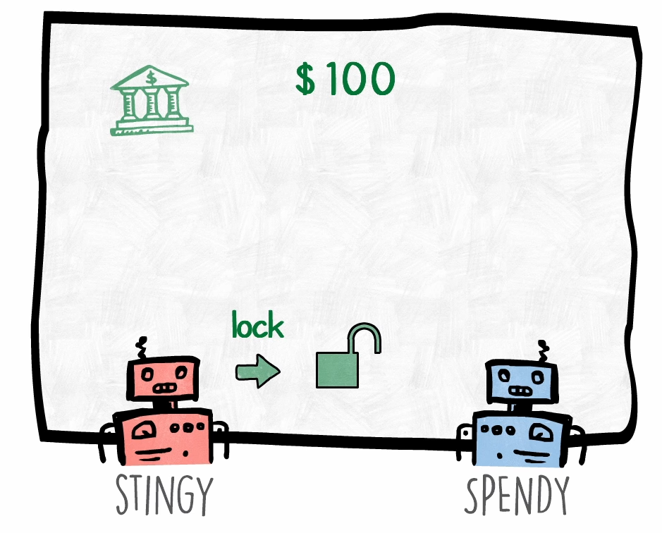
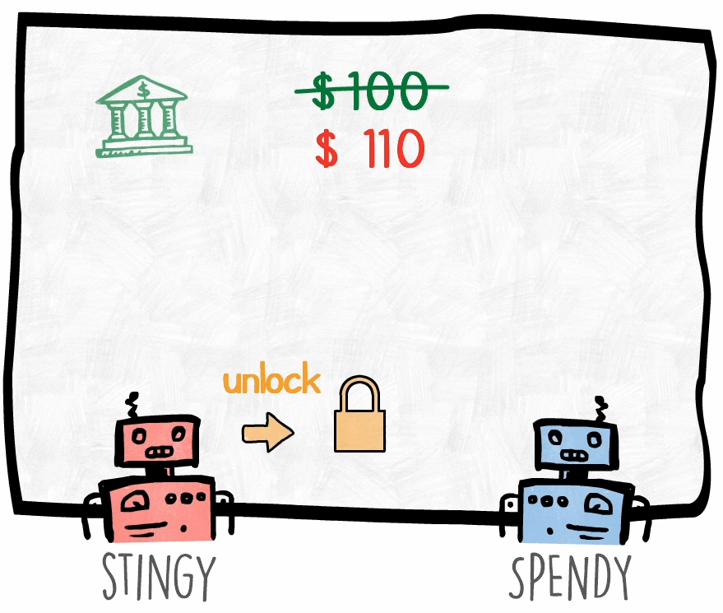
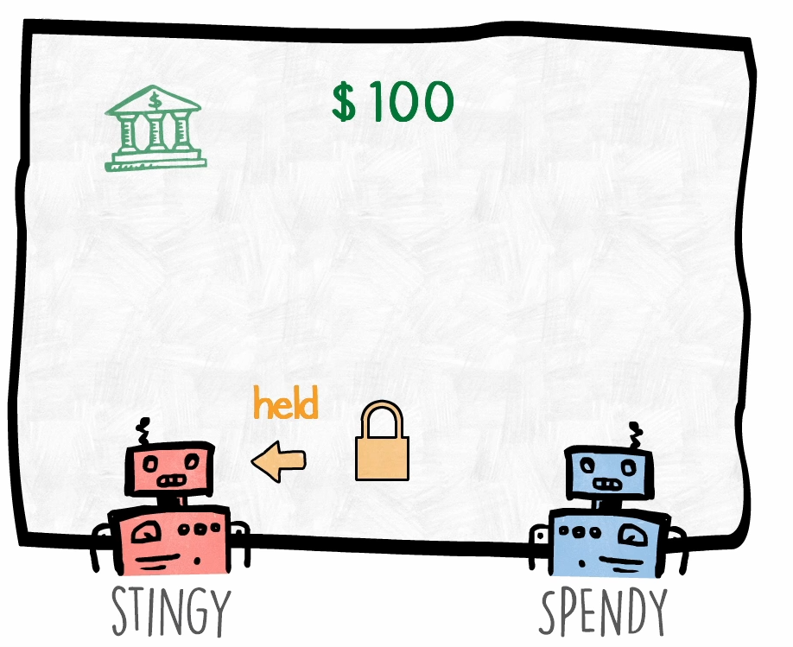
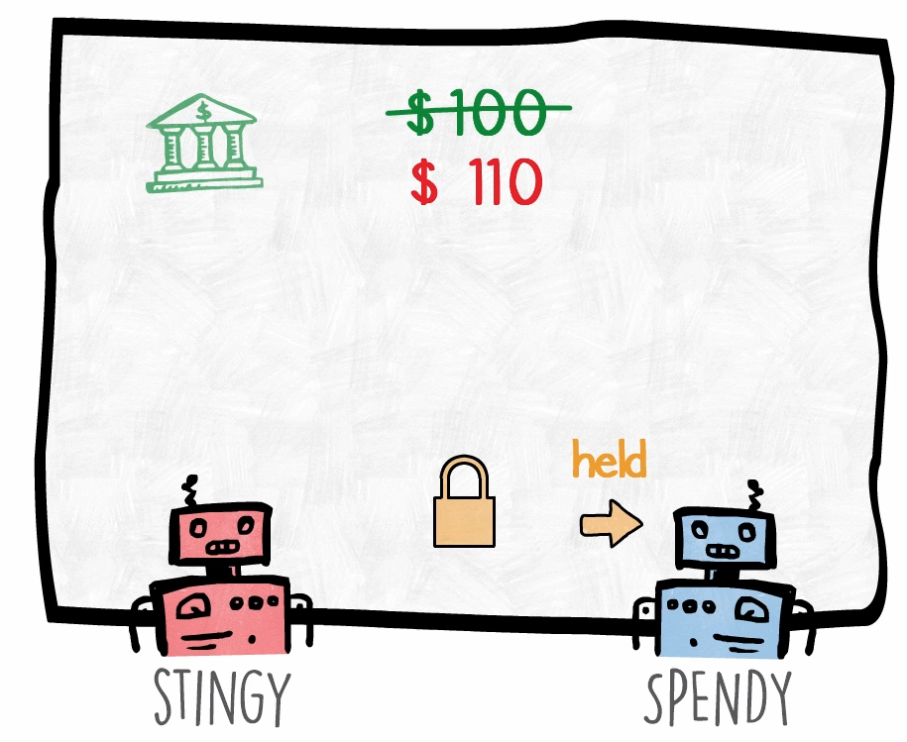
Using Mutex
Step 1: Stingy would ask for a lock (mutex)
Step 2: Since no one is holding the mutex, Stingy gets it
Step 3: Stingy thread updates balance and releases mutex
Step 4: Now if Spendy locks it, updated balance will be seen

Slide 66
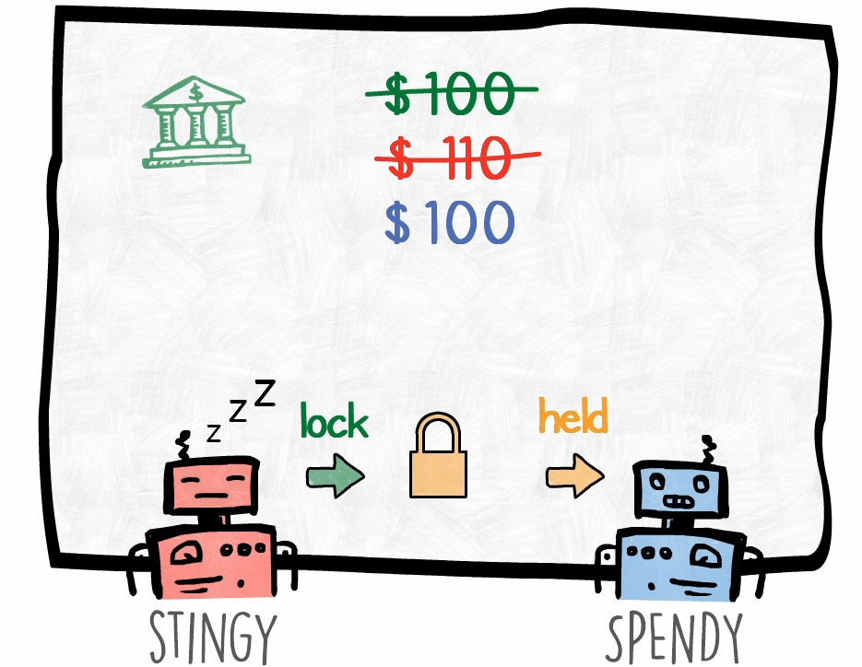
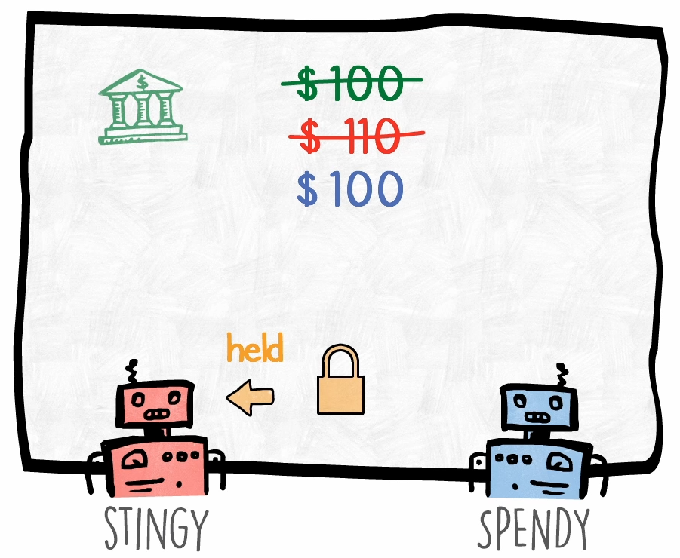
What if a Locked Resource is Wanted by Another Thread?
Currently, the spendy thread is holding mutex on the balance and stingy again wants the mutex … It must go to sleep and wait till spendy releases it!

Slide 67
Mutex Example: C:\lectures\CDAC\DAC\stingy_spendy_mutex.py
import time
from threading import Thread, Lock
class StingySpendy:
money = 100
mutex = Lock()
def stingy(self):
for i in range(5000000):
self.mutex.acquire()
self.money += 10
self.mutex.release()
print("Stingy Done")
def spendy(self):
for i in range(5000000):
self.mutex.acquire()
self.money -= 10
self.mutex.release()
print("Spendy Done")
ss = StingySpendy()
Thread(target=ss.stingy, args=()).start()
Thread(target=ss.spendy, args=()).start()
time.sleep(5)
print("Money in the end", ss.money)

Slide 68
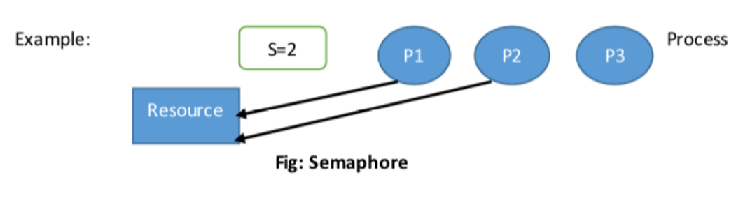
Semaphore versus Mutex
Semaphore is a signaling mechanism.
Semaphore restricts the number of simultaneous users of a shared resource up to a maximum number.
Threads can request access to the resource (decrementing the semaphore) and can signal that they have finished using the resource (incrementing the semaphore).
It allows number of thread to access shared resources.

Slide 69
Main Differences
Mutex is locking mechanism ownership method. Semaphore is a signaling mechanism.
Mutex works in user space but semaphore works in kernel space.
Mutex is generally binary, semaphore is an integer.

Slide 70
Producer-Consumer Problem
Producer-consumer problem is also known as the bounded-buffer problem
Two processes share a common fixed-size buffer
The producer puts information in
The consumer takes it out
If the producer wants to write more information but the buffer is full, the producer goes to sleep and is woken up when the consumer removes one or more items from the buffer
If the consumer wants to read more information but the buffer is empty, the consumer goes to sleep and is woken up when the producer adds one or more items to the buffer

Slide 71
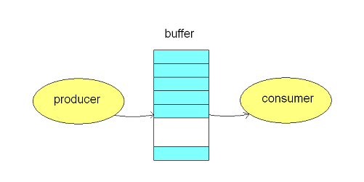
Producer-Consumer Problem

Slide 72
The Variables
We will have a count variable that indicates the current number of items in the buffer
Another variable n will indicate the maximum capacity of the buffer
The producer checks if count equals n
If yes, it goes to sleep
If not, it adds an item and increments count
The consumer checks if count equals 0
If yes, it goes to sleep
If not, it removes an item and decrements count
Both producer and consumer check if the other needs to be awakened, and if yes, do so

Slide 73
Race Condition
A problem called as race condition can occur because there are no restrictions on accessing the count variable
Suppose the buffer is empty and the consumer has just read the count variable to find its value as 0
Naturally, the scheduler will stop the consumer and decide to start the producer
The producer inserts an item in the buffer and increments the count and notices that it is now 1
Since count was 0 and thus the consumer must be sleeping, the producer tries to wake up the consumer
However, the consumer was not sleeping, and hence this wake up call is lost
The consumer still thinks that count = 0, so it will go to sleep
Sooner or later, the producer will fill the buffer and also go to sleep
Both will sleep forever
Solution: Semaphore, discussed earlier

Slide 74
semaphore.py
# importing the modules
from threading import *
import time
# creating thread instance where count = 3
obj = Semaphore(3)
# creating instance
def display(name):
# calling acquire method
obj.acquire()
for i in range(5):
print('Hello, ', end = '')
time.sleep(1)
print(name)
# calling release method
obj.release()
# creating multiple thread
t1 = Thread(target = display , args = ('Thread-1',))
t2 = Thread(target = display , args = ('Thread-2',))
t3 = Thread(target = display , args = ('Thread-3',))
t4 = Thread(target = display , args = ('Thread-4',))
t5 = Thread(target = display , args = ('Thread-5',))
# calling the threads
t1.start()
t2.start()
t3.start()
t4.start()
t5.start()

Slide 75
mutex.py
# example of a mutual exclusion (mutex) lock
from time import sleep
from random import random
from threading import Thread
from threading import Lock
# work function
def task(lock, identifier, value):
# acquire the lock
with lock:
print(f'>thread {identifier} got the lock, sleeping for {value}')
sleep(value)
# create a shared lock
lock = Lock()
# start a few threads that attempt to execute the same critical section
for i in range(10):
# start a thread
Thread(target=task, args=(lock, i, random())).start()
# wait for all threads to finish...

Slide 76
Starvation
Consider allocation of a printer to processes
Suppose the OS allocates the printer to the process that needs to print the smallest file
Consider a busy system where a process has a large file to print
Every time the printer gets free, the OS will decide to allocate the printer that needs to print the smallest file
Thus, the process needing to print the file will face starvation
Starvation = A process postponed indefinitely, even though it is not blocked
Solution: We can use FIFO

Slide 77
Starvation and Deadlock
Deadlock and starvation are not the same
A deadlock-free solution does not necessarily eliminate the possibility of starvation
Hence, they need different solutions

